Slide 1
Programming Building Blocks
Data-processing Instructions
Conditional Execution
Branches
High-level Constructs:
  if/else statements
  for loops
  while loops
  arrays
  function calls

Slide 2
Data-processing Instructions
Logical operations
Shifts / rotate
Multiplication

Slide 3
Logical Instructions
AND
ORR
EOR (XOR)
BIC (Bit Clear = A & ~B)
MVN (MoVe and NOT)

Slide 4
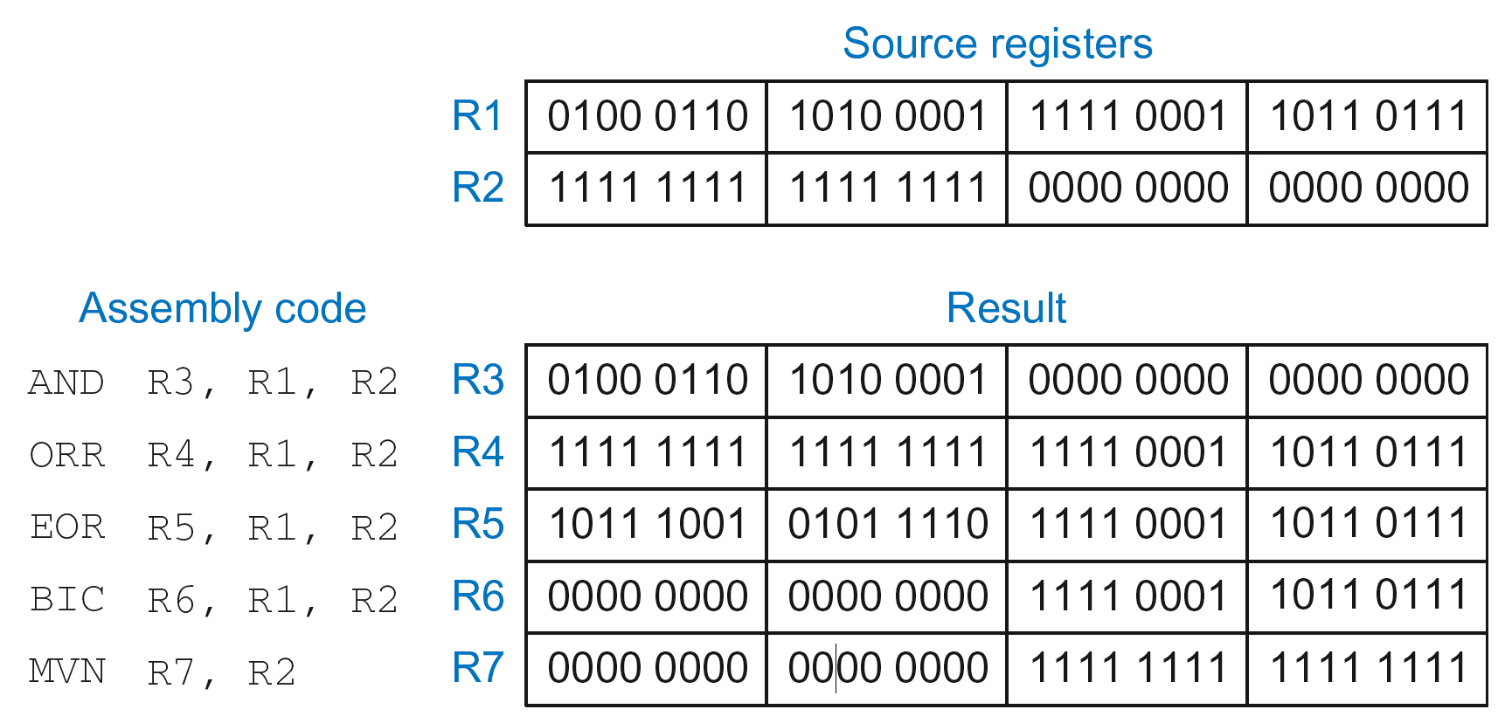
Logical Instructions: Examples

Slide 5
Logical Instructions: Uses
AND or BIC: useful for masking bits
  Example: Masking all but the least significant byte of a value
  0xF234012F AND 0x000000FF = 0x0000002F
  0xF234012F BIC 0xFFFFFF00 = 0x0000002F
ORR: useful for combining bit fields
  Example: Combine 0xF2340000 with 0x000012BC:
  0xF2340000 ORR 0x000012BC = 0xF23412BC

Slide 6
Shift Instructions
LSL: logical shift left
  Example: LSL R0, R7, #5 ; R0 = R7 << 5
LSR: logical shift right
  Example: LSR R3, R2, #31 ; R3 = R2 >> 31
ASR: arithmetic shift right
  Example: ASR R9, R11, R4 ; R9 = R11 >>> R4_{7:0}
ROR: rotate right
  Example: ROR R8, R1, #3 ; R8 = R1 ROR 3

Slide 7
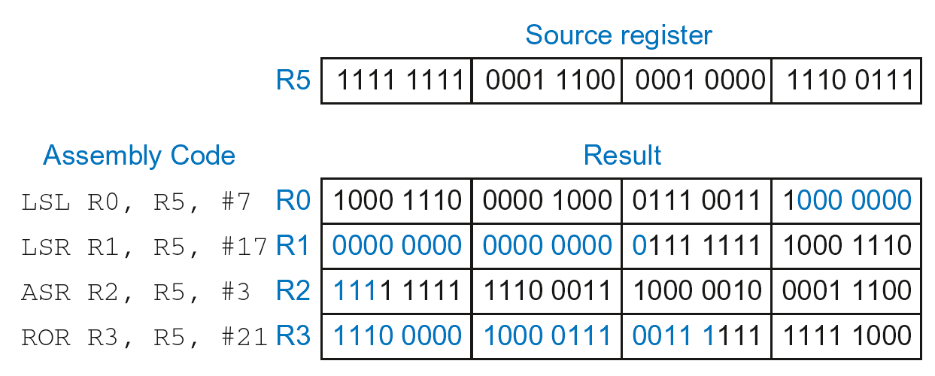
Shift Instructions: Example 1
Immediate shift amount (5-bit immediate)
Shift amount: 0-31

Slide 8
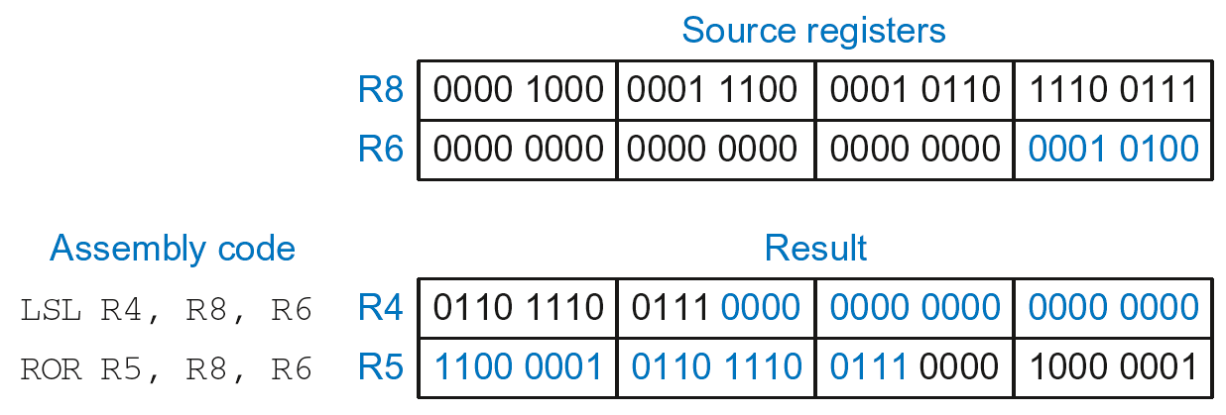
Shift Instructions: Example 2
Register shift amount (uses low 8 bits of register)
Shift amount: 0-255

Slide 9
Multiplication
MUL: 32 × 32 multiplication, 32-bit result
  MUL R1, R2, R3
  Result: R1 = (R2 x R3)_{31:0} (signed doesn’t matter)
UMULL: Unsigned multiply long: 32 × 32 multiplication, 64-bit result
  UMULL R1, R2, R3, R4
  Result: {R1,R4} = R2 x R3 (R2, R3 unsigned)
SMULL: Signed multiply long: 32 × 32 multiplication, 64-bit result
  SMULL R1, R2, R3, R4
  Result: {R1,R4} = R2 x R3 (R2, R3 signed)

Slide 10
Programming Building Blocks
Data-processing Instructions
Conditional Execution
Branches
High-level Constructs:
  if/else statements
  for loops
  while loops
  arrays
  function calls

Slide 11
Conditional Execution
Don’t always want to execute code sequentially
For example:
  if/else statements, while loops, etc.: only want to execute code if a condition is true
  branching: jump to another portion of code if a condition is true

Slide 12
Conditional Execution
Don’t always want to execute code sequentially
For example:
  if/else statements, while loops, etc.: only want to execute code if a condition is true
  branching: jump to another portion of code if a condition is true
ARM includes condition flags that can be:
  set by an instruction
  used to conditionally execute an instruction

Slide 13
ARM Condition Flags
Flag | Name | Description
N | Negative | Instruction result is negative
Z | Zero | Instruction results in zero
C | Carry | Instruction causes an unsigned carry out
V | oVerflow | Instruction causes an overflow
Set by ALU (recall from Chapter 5)
Held in Current Program Status Register (CPSR)

Slide 14
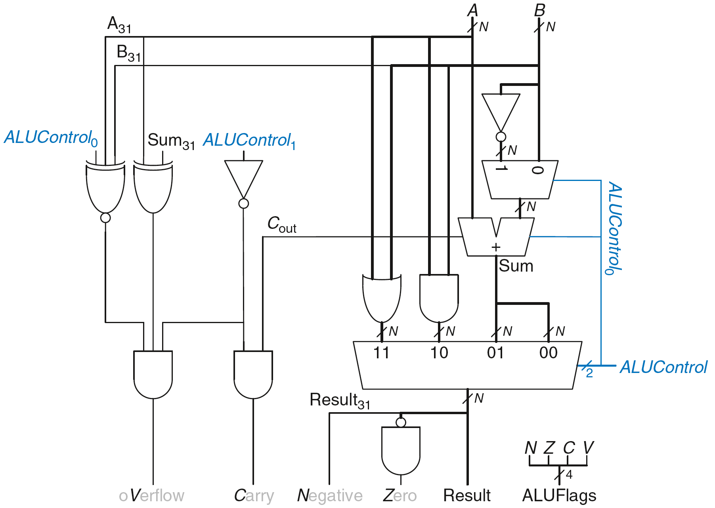
Review: ARM ALU

Slide 15
Setting the Condition Flags: NZCV
Method 1: Compare instruction: CMP
  Example: CMP R5, R6
    Performs: R5-R6
    Does not save result
    Sets flags. If result:
      Is 0, Z=1
      Is negative, N=1
      Causes a carry out, C=1
      Causes a signed overflow, V=1

Slide 16
Setting the Condition Flags: NZCV
Method 1: Compare instruction: CMP
  Example: CMP R5, R6
    Performs: R5-R6
    Sets flags: If result is 0 (Z=1), negative (N=1), etc.
    Does not save result
Method 2: Append instruction mnemonic with S
  Example: ADDS R1, R2, R3
    Performs: R2 + R3
    Sets flags: If result is 0 (Z=1), negative (N=1), etc.
    Saves result in R1

Slide 17
Condition Mnemonics
Instruction may be conditionally executed based on the condition flags
Condition of execution is encoded as a condition mnemonic appended to the instruction mnemonic
  Example: CMP R1, R2
  SUBNE R3, R5, R8
        NE: not equal condition mnemonic
        SUB will only execute if R1 ≠ R2
        (i.e., Z = 0)

Slide 18
Condition Mnemonics

Slide 19
Conditional Execution
Example:
  CMP R5, R9 ; performs R5-R9
  ; sets condition flags
  SUBEQ R1, R2, R3 ; executes if R5==R9 (Z=1)
  ORRMI R4, R0, R9 ; executes if R5-R9 is
  ; negative (N=1)
  Suppose R5 = 17, R9 = 23:
    CMP performs: 17 – 23 = -6 (Sets flags: N=1, Z=0, C=0, V=0)
    SUBEQ doesn’t execute (they aren’t equal: Z=0)
    ORRMI executes because the result was negative (N=1)

Slide 20
Programming Building Blocks
Data-processing Instructions
Conditional Execution
Branches
High-level Constructs:
  if/else statements
  for loops
  while loops
  arrays
  function calls

Slide 21
Branching
Branches enable out of sequence instruction execution
Types of branches:
  Branch (B)
    branches to another instruction
  Branch and link (BL)
    discussed later
Both can be conditional or unconditional

Slide 22
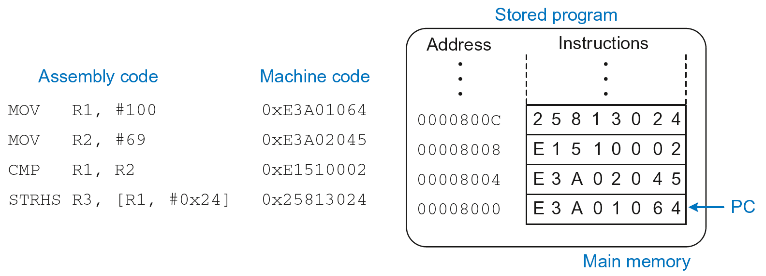
The Stored Program

Slide 23
Unconditional Branching (B)
ARM assembly
MOV R2, #17 ; R2 = 17
B TARGET ; branch to target
ORR R1, R1, #0x4 ; not executed
TARGET
SUB R1, R1, #78 ; R1 = R1 - 78
Labels (like TARGET) indicate instruction location. Labels can’t be reserved words (like ADD, ORR, etc.)

Slide 24
The Branch Not Taken
ARM Assembly
MOV R0, #4 ; R0 = 4
ADD R1, R0, R0 ; R1 = R0+R0 = 8
CMP R0, R1 ; sets flags with R0-R1
BEQ THERE ; branch not taken (Z=0)
ORR R1, R1, #1 ; R1 = R1 OR R1 = 9
THERE
ADD R1, R1, 78 ; R1 = R1 + 78 = 87

